Slide 1

My Linear Relationships Interactive Notebook
Name
Class
Term 3 Semester 2

Slide 2
Contents
Formula Page
Page
Date
Description
2
3

Slide 3
Tasks
24
7
30
Essential Question
Questions
Notes
Summary
10
11

Slide 4
24
7
30
Date
Drawing Linear Graphs
EQ – How do you draw a graph given the equation?
11

Slide 5
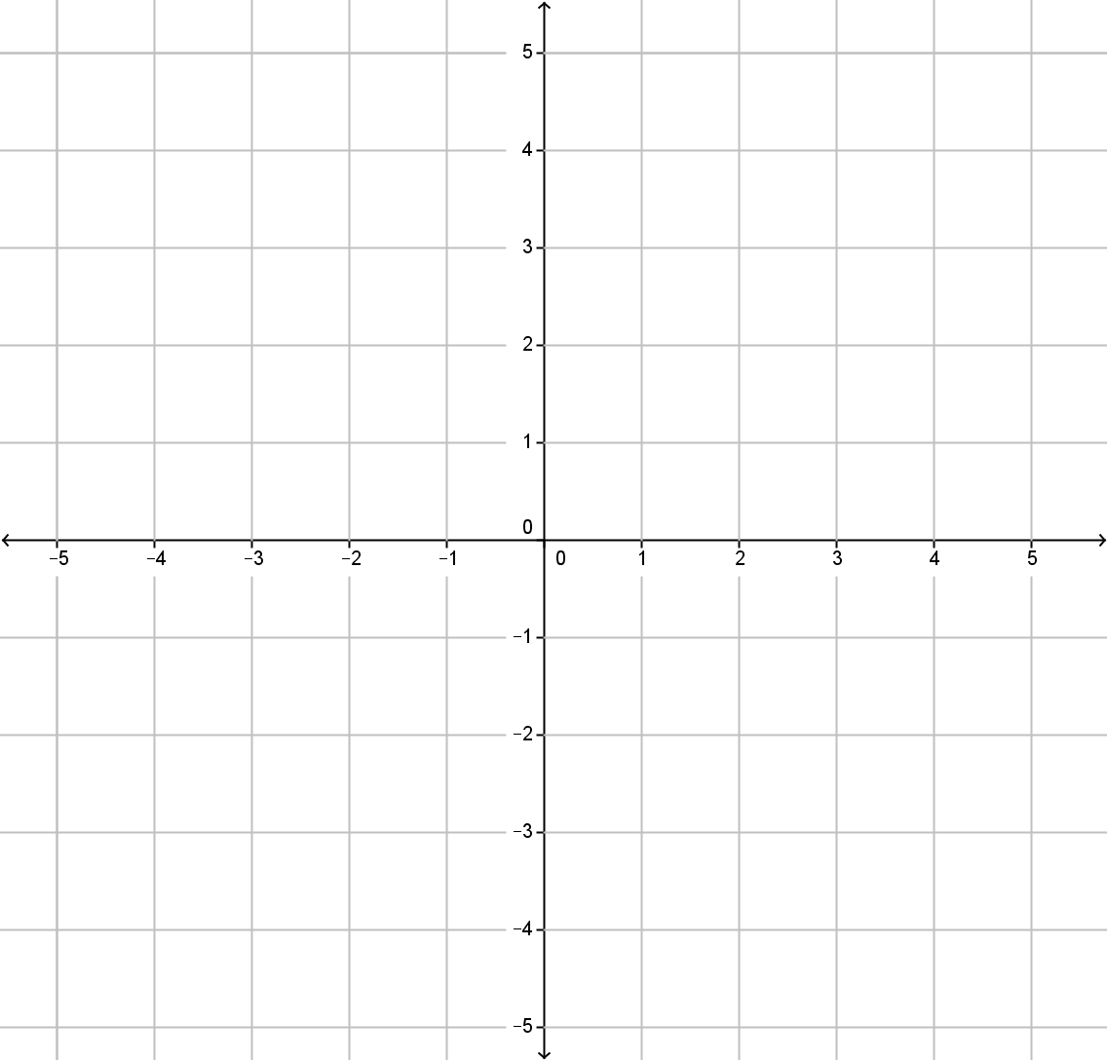
Draw a coordinate grid from -5 to 5 on both axes.

Slide 6
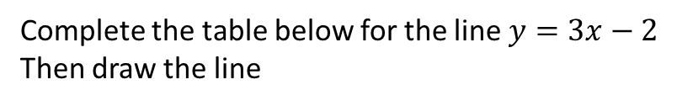
24
7
30
Date
Drawing Linear Graphs
EQ – How do you draw a graph given the equation?
Complete the table below for the line $y=3x−2$
Then draw the line
x | -2 | -1 | 0 | 1 | 2 | 3
y
11

Slide 7
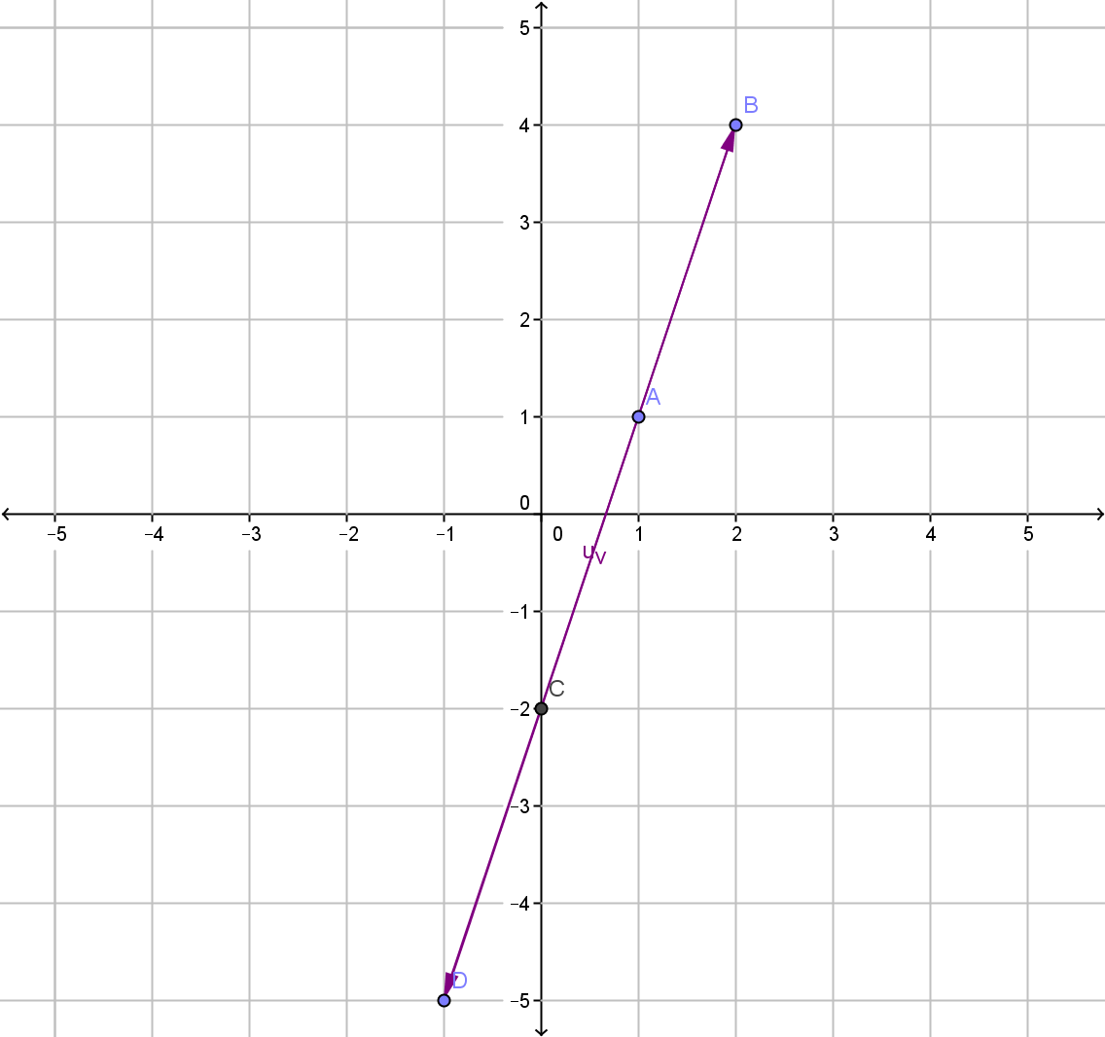
24
7
30
Date
Drawing Linear Graphs
EQ – How do you draw a graph given the equation?
Complete the table below for the line $y=3x−2$
Then draw the line
x | -2 | -1 | 0 | 1 | 2 | 3
y | -8 | -5 | -2 | 1 | 4 | 7
Ordered pairs (-2,-8), (-1,-5), (0,-2) etc
Note: first number is for the horizontal axis and the other is for vertical the axis
11

Slide 8
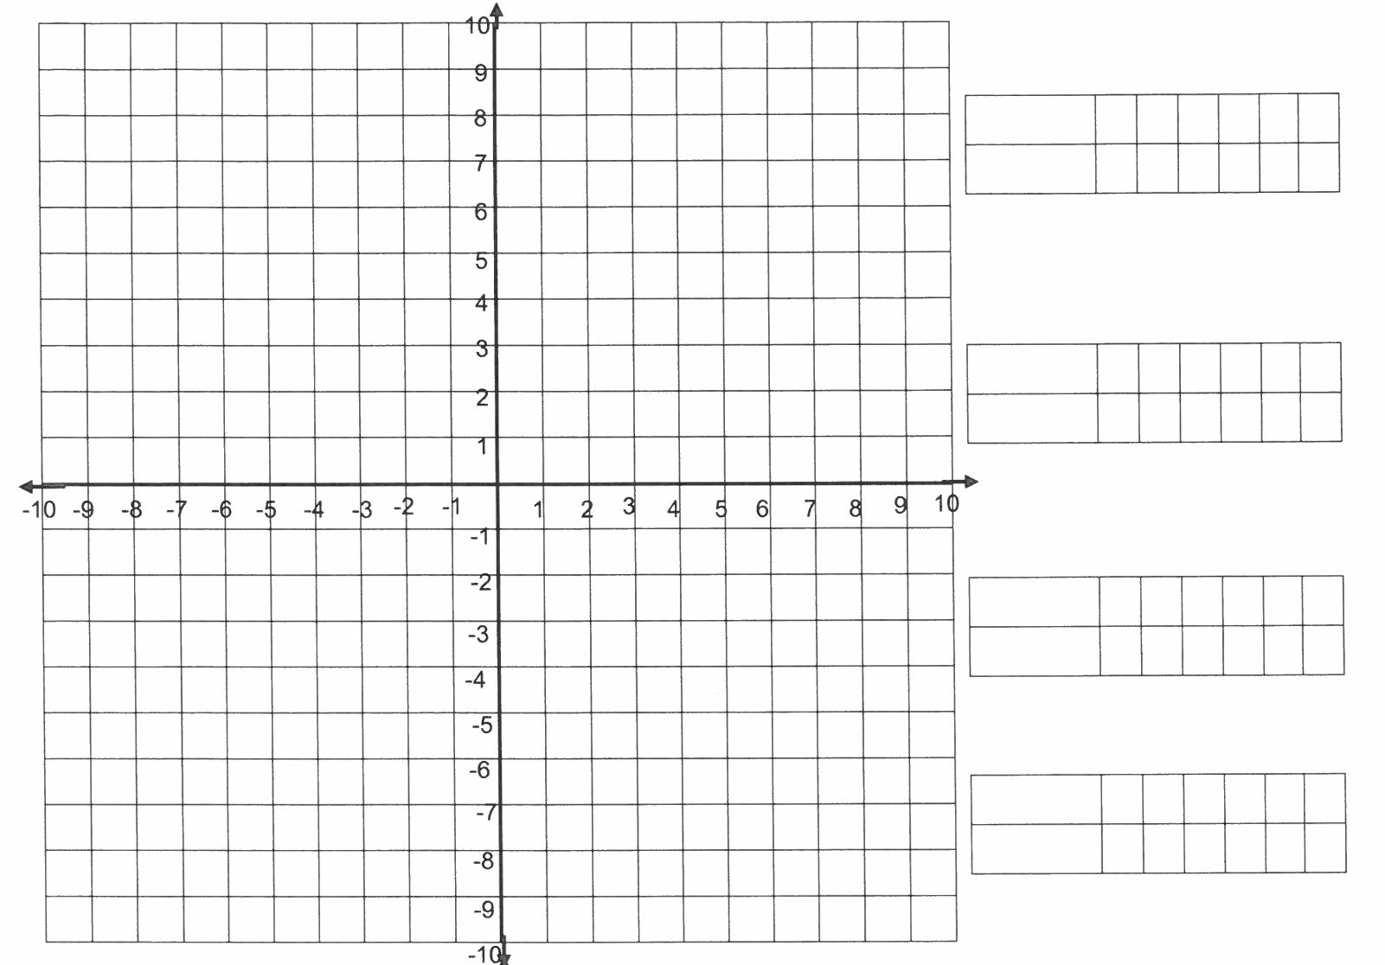
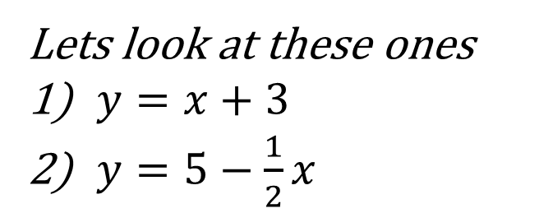


Lets look at these ones
$y=x+3$
$y=5−\frac{1}{2}x$
$$y=x+3$$
$$y=5−\frac{1}{2}x$$

Slide 10
Questions Exercise 4A Pgs 198 - 201

Slide 11
Notes Review
24, 7 ,30
Date
Title
Essential question
Notes complete
Notes complete with colour and diagrams
Questions completed
Contents page filed in
Formula page filled in

Slide 12
Homework
Review your notes and write a summary answering the essential question.

